Slide 1
Optimizing Email Targeting for Miles Promotion
Tolu Olusooto
Plusgrade
Feb 21, 2025

Slide 2
Business Problem
Marketing department is launching a Miles Promotion
500K total members, but only 100K can receive the promotional email
Goal: Develop a propensity model to identify members most likely to engage
Key target variable: "cur_target" (1 = member transacted in the campaign)

Slide 3
Data Overview
Training data includes historical transactions, demographics, and engagement features
Key data types:
Flight Activity: Number of segments flown, promo flights, base flights.
Spending Behavior: Affinity spend, non-flight miles earned/redeemed, partner miles.
Membership attributes (e.g., enrollment date, current tier, email subscriptions)
Data Distribution Insights:
Imbalanced target variable: Low conversion rate (<1%) in historical data.
Skewed distributions: Spending, miles earned, and flight activity show long-tail distributions.
Most members have low engagement levels

Slide 4
Data Overview Cont’d
Missing Data Considerations
Date of birth (<1%) took the median
Indicator Variables: For missing categorical values.
Segmenting missing from actual data via large value imputation
Potential Data Leakage Risks
3 feature were in the same time period as the promotion
Average price transacted with during the promo period
How often and when did the member visit the site during the promo period

Slide 5
Feature Engineering
Feature Correlations & Engineering
Highly correlated features:
Flight segments, promo flights, and base flights (r > 0.90) → Combined into flight_activity.
Affinity spend & non-flight miles earned (r > 0.96) → aggregated into non_flight_activity
Removed 3 month specific features: Weaker and redundant compared to 12 month features
Derived Features:
Date features: Converted to numerical value representation of the time.
Normalized and scaled numerical variables (MinMax Scaling, log transformation)
Encoded categorical variables (Ordinal for tiers, One-Hot for opt-ins)

Slide 6
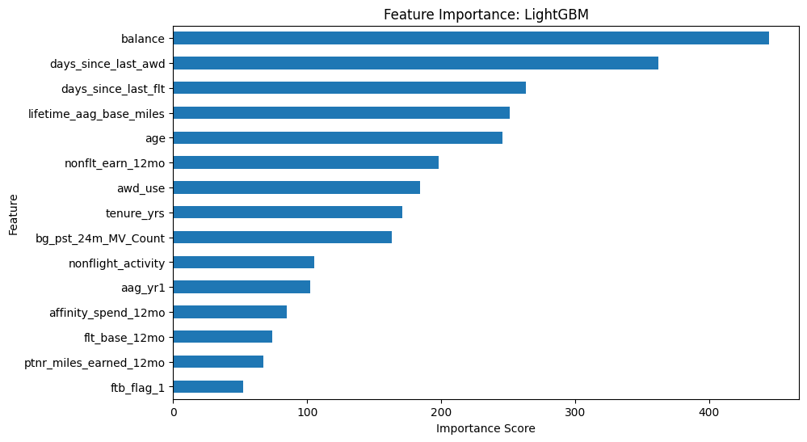
Feature Section
XgBoost Feature Selection: Handles missing values
Feature Importance: If largely missing feature worth imputing
Tested the effectiveness of derived features and relevance of orginal
Highly correlated features:
Flight segments, promo flights, and base flights (r > 0.90) → Combined into flight_activity.
Affinity spend & non-flight miles earned (r > 0.96) → aggregated into non_flight_activity
Removed 3 month specific features: Weaker and redundant compared to 12 month features
Derived Features:
Date features: Converted to numerical value representation of the time.

Slide 7
Model Approach
Multiple models trained and compared:
Logistic Regression (Baseline and in case feature to target relationship is strongly linear)
XGBoost (Boosted decision tree, handles non-linearity well)
LightGBM (Faster gradient boosting with better handling of imbalanced data)
Balanced Random Forest (Resampling technique for class imbalance)
Hyperparameter tuning via GridSearchCV
Class imbalance addressed using weighted loss functions and resampling

Slide 8
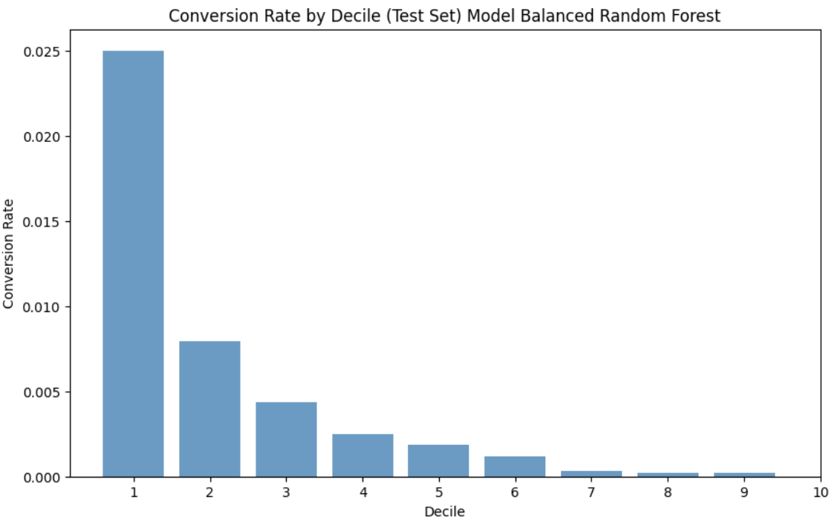
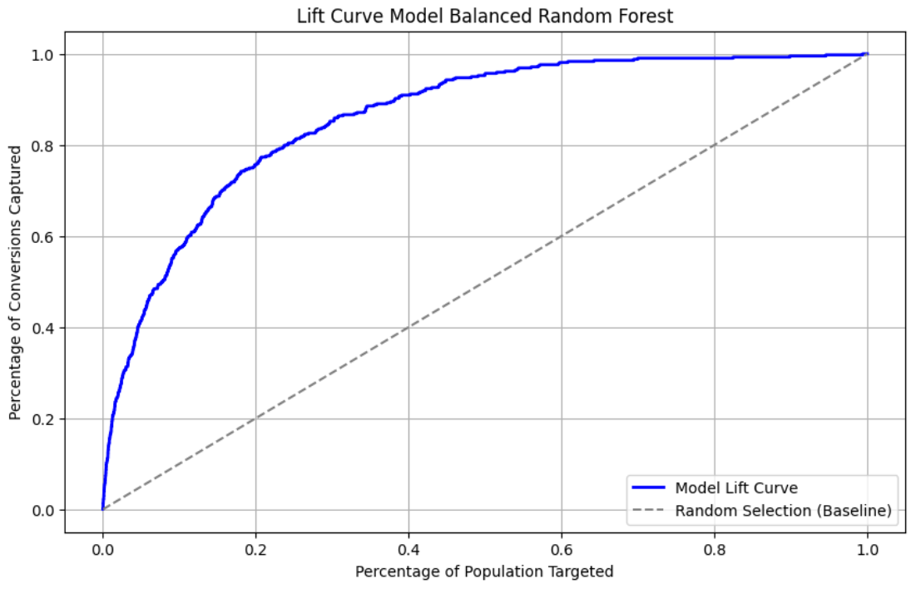
Model Performance Metrics
Evaluated using:
Precision-Recall AUC: (due to class imbalance)
Lift Score: (Measures effectiveness in prioritizing high-converting members)
F1-score, Accuracy, Precision, Recall
Key takeaway: Balanced Random Forest performed best followed by XGBoost
Lift Score: ~5.7
Recall: ~0.98

Slide 9
Key Insights & Recommendations
Insights:
Higher-tier members & frequent flyers are more likely to engage
Spending efficiency & past promo engagement are strong predictors
Long time members are more engaged
Recommendations:
Target members in top deciles for maximum impact
Refine marketing strategy based on engagement trends
A/B testing on selected vs. non-selected members.
Impact of Model:
Identifies high-propensity members for email targeting.
Enables efficient allocation of marketing budget by focusing on top segments.
Reduces email fatigue by eliminating low-propensity members.

Slide 10
Q&A

